Slide 1
Big Data, AI, Machine Learning, Investment and Algo Trading
Ken Liu

Slide 2
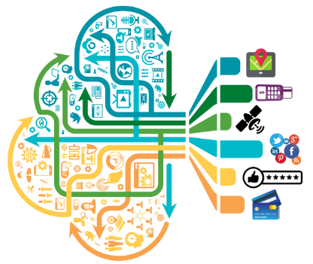
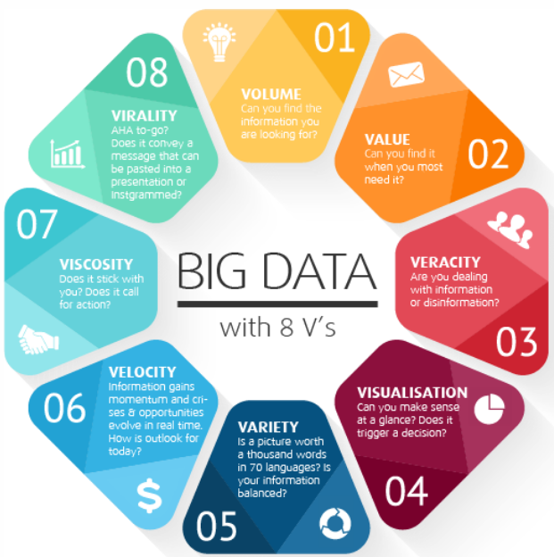

Big & Alternative Data

Slide 3
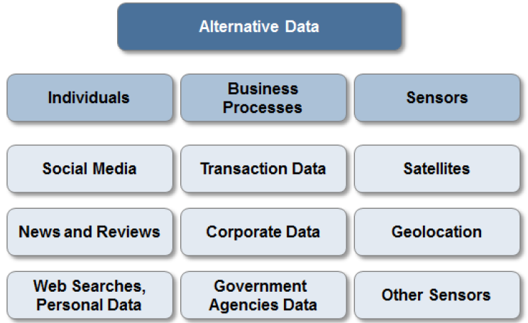
Alternative Data

Slide 4
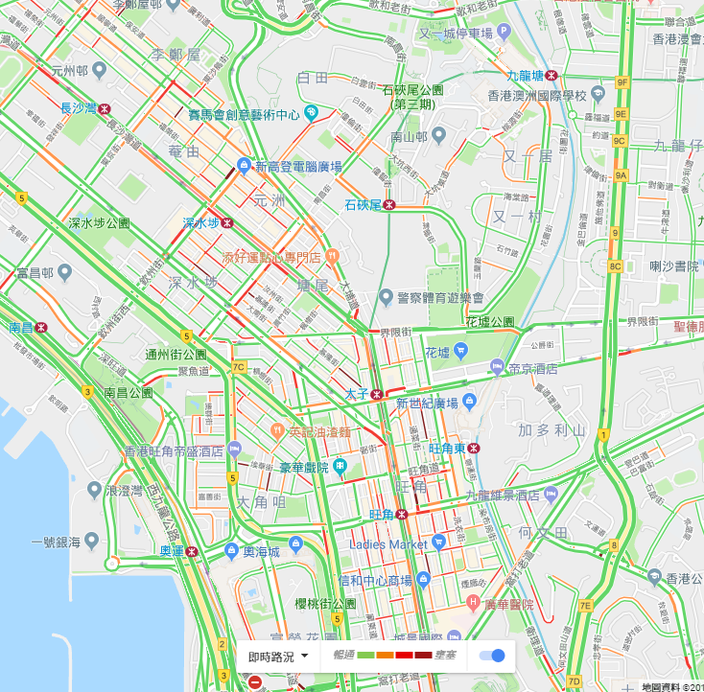
Individuals: Digital Footprints
How Google knows the traffic ?
1. From HK Transport Department ?
2. From Satellite Images ?
3. From You ?
Analyzing the GPS locations transmitted to Google by a large number of mobile phone users. By calculating the speed of users along a length of road, Google is able to generate a live traffic map
An Artist Used 99 Phones to Fake a Google Maps Traffic Jam

Slide 5

Individuals: Digital Footprints
Do you see Lantau Island from the Windows
Location information is very important !

Slide 6
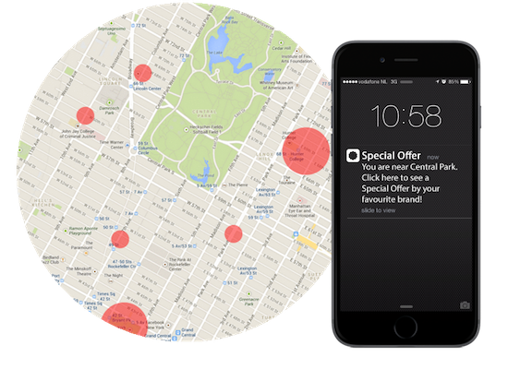
Individuals: Digital Footprints
身體最誠實 Your actions reveal the truth
Many Apps request location permissions to do Geo-fencing

Slide 7
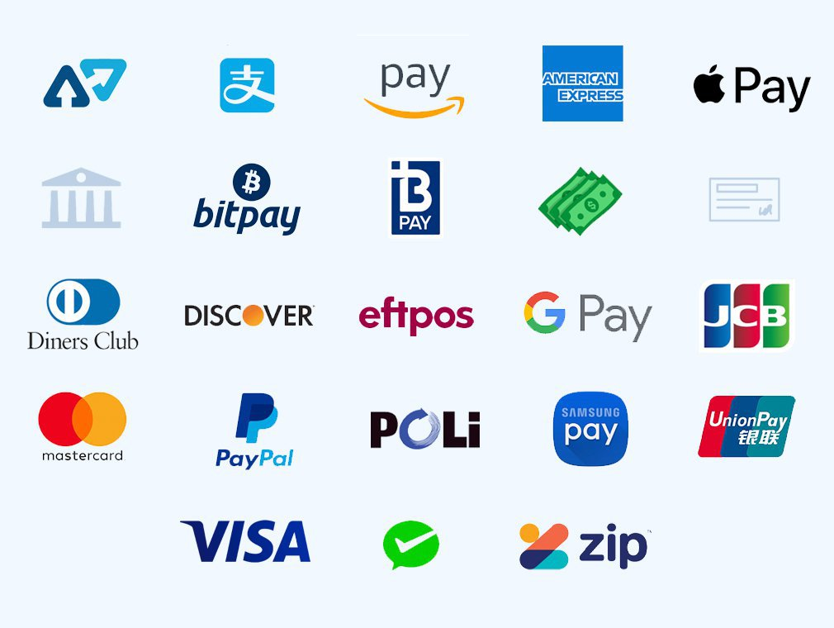

Business Processes
Commercial transactions: e-commerce, payments, credit card spending
Private agencies: supply chain data, intra-day tick data from the exchange
Other ideas:
Track the best sales products and break down the underlying raw material for investing
Mobile payment transaction used for in credit risk modelling

Slide 8

Business Processes
Big Data affairs (similar to Andy & Jacqueline 安心事件)
How Target Figured Out A Teen Girl Was Pregnant Before Her Father Did
data-mine its way into your womb, to figure out whether you have a baby on the way long before you need to start buying diapers
Woman wrongly accused boyfriend of having affair after Tesco added condoms to their online shopping list
It gives a list of everything bought on a ClubCard and there at the top of the list was a packet of Mates condoms

Slide 9

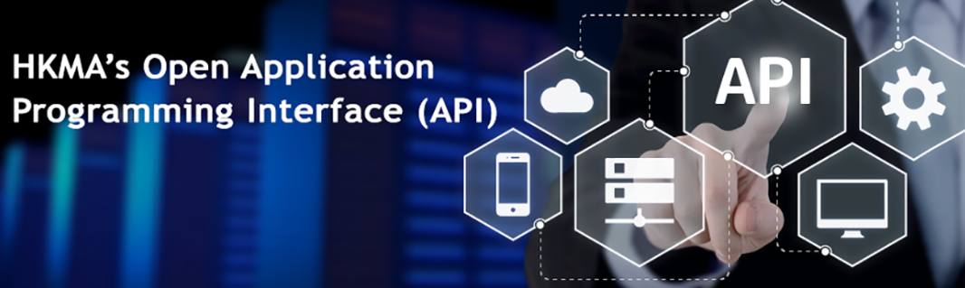


Business Processes: Government
Example: ESG Funds
Open Data API Demo
Notes:
FB post and comment is like news vs social feeds

Slide 10
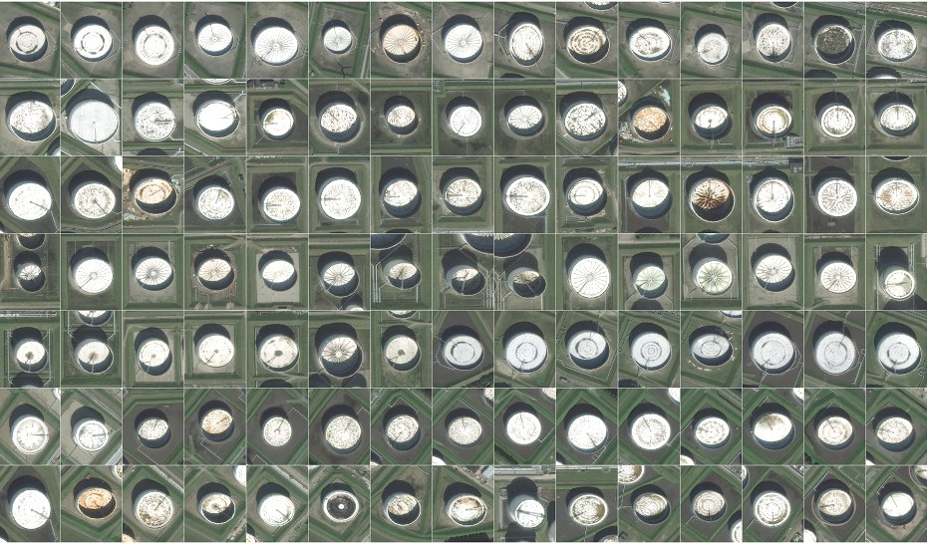
Satellite image: Oil Reserve
Oil reserves are often stored in floating tanks around the world, whose lid rises and falls with increasing or decreasing storage. With the rising and falling height, the crescent-shaped shadows cast by the sun also change shape. By tracking these shape changes (Deep Learning - CNN), Orbital Insights predicts oil inventory levels. https://www.wired.com/2015/03/orbital-insight/

Slide 11
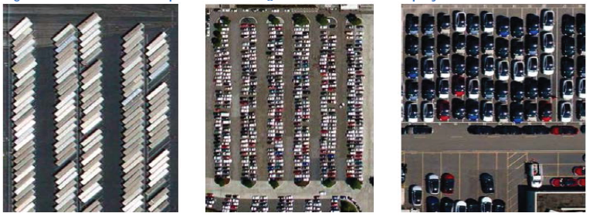
Satellite image: Parking Lots
Satellite Imagery of Parking Lots and Trading Retail Stocks from RS Metrics - uses ~10 high-resolution satellites, orbiting the Earth and imaging between the store opening hours. Such data can be used to estimate retail traffic (e.g. at some ~50 retail chains)
Other Ideas:
Road cameras (video) to gauge car brands popularity
In class students facial expressions to predict the class effectiveness

Slide 12
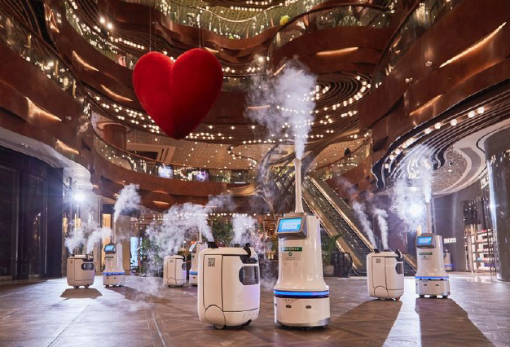
IoT, Sensors, Robots
Staying time
Walking pace
Crowdedness
Customer satisfaction
Not just to replace “Sodiasm”. The robots equip with sensor to collect data

Slide 13
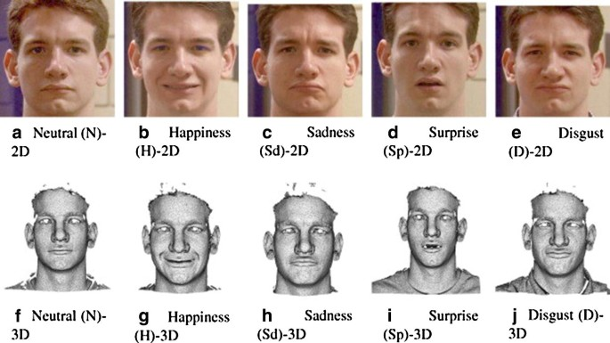
IoT, Sensors, Robots
3D Facial Recognition

Slide 14
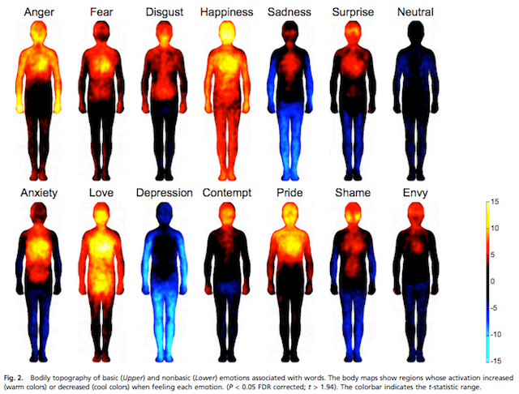
IoT, Sensors, Robots
Bodily Topography

Slide 15

Example: Usage
Satellite imagery showing that a particular store’s parking lot was always full
Correlated with credit card transactions showing a spike in sales
Alongside social media analysis indicating an unprecedented rate of content generation from inside the store
What would you do?
A month later, when the company announces a breakthrough in sales, you’re ahead of the game.

Slide 16
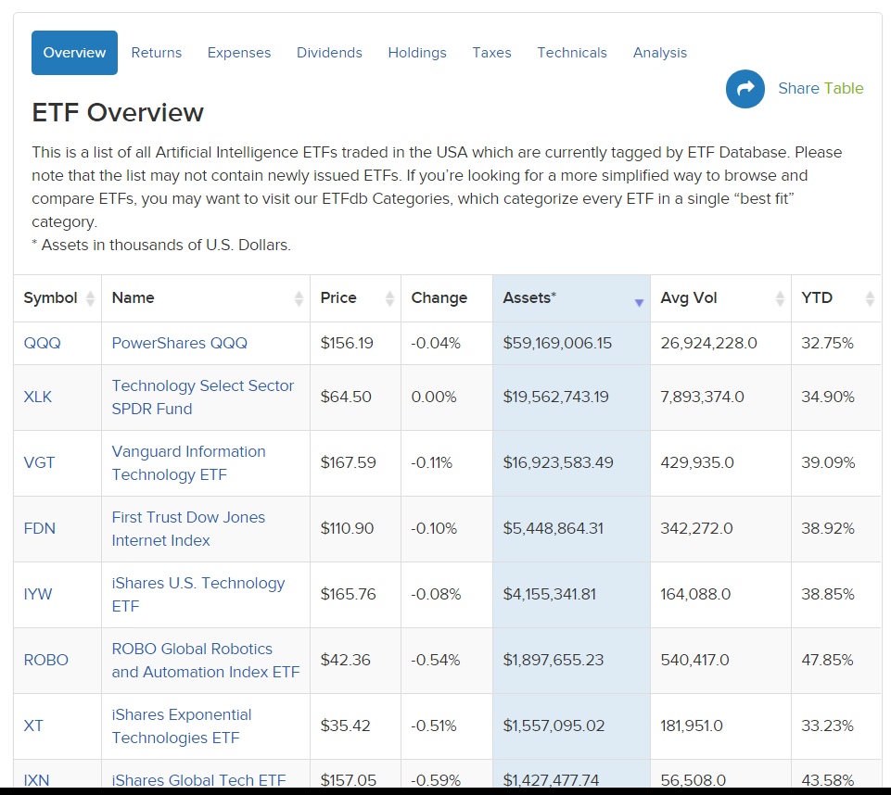
Example: AI ETF
Robo-Advisor (AI ETF) and leverage big & alternative data source
Text: Social Media, News
Images: satellite image on oil fields and others from SpaceKnow
Videos: road cameras of cars

Slide 17
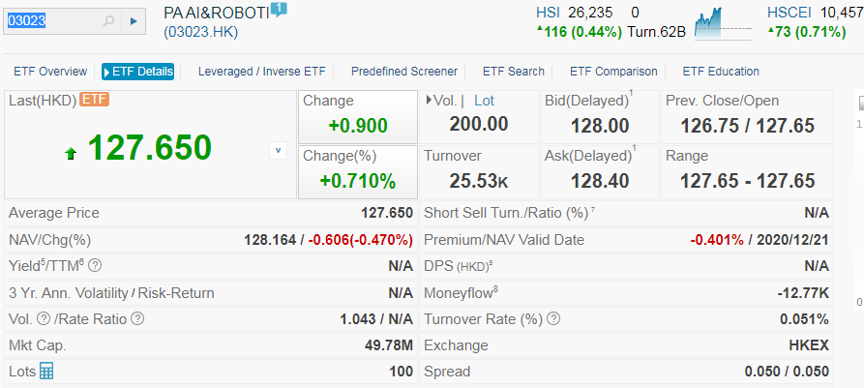
Example: AI ETF
Ping An Nasdaq AI and Robotics ETF (3023.HK)
an exchange-traded fund incorporated in Hong Kong. The fund seeks to track the performance of Nasdaq CTA Artificial Intelligence and Robotics Index.

Slide 18
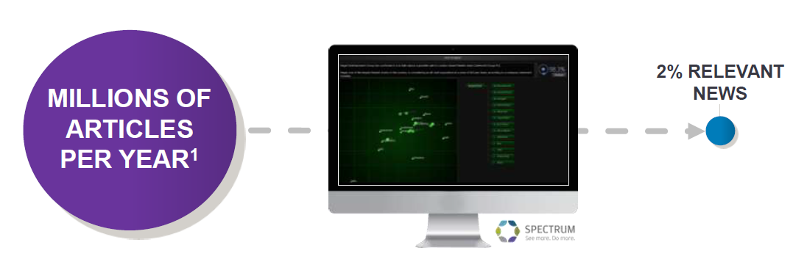
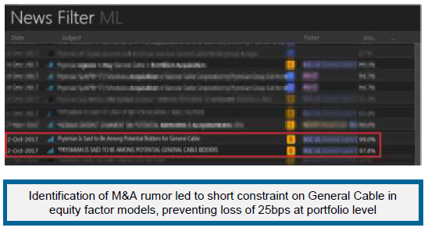
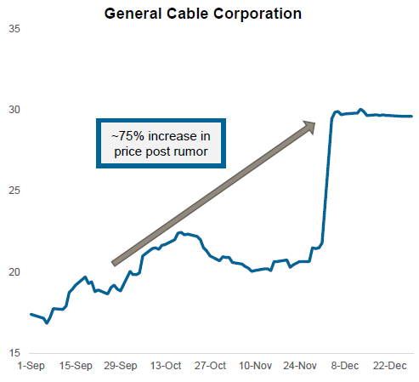
Example: News and Sentiments
Source: J.P. Morgan Asset Management, Bloomberg

Slide 19
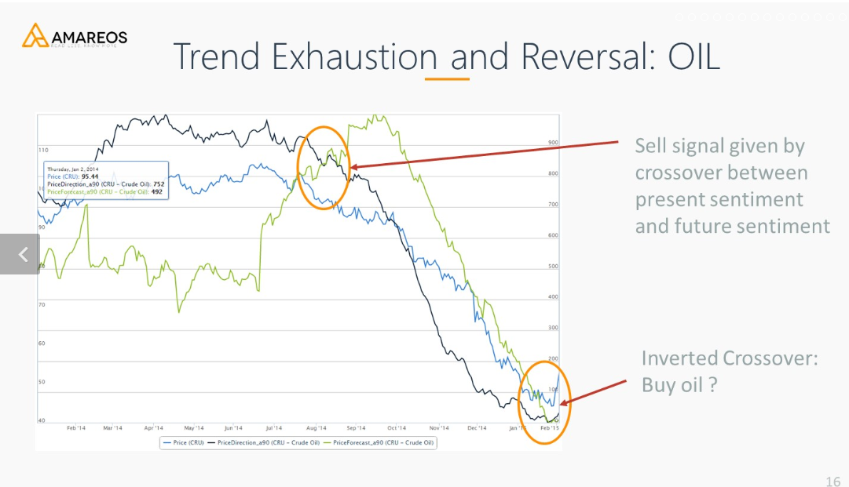
Example: Sentiment Analysis

Slide 20
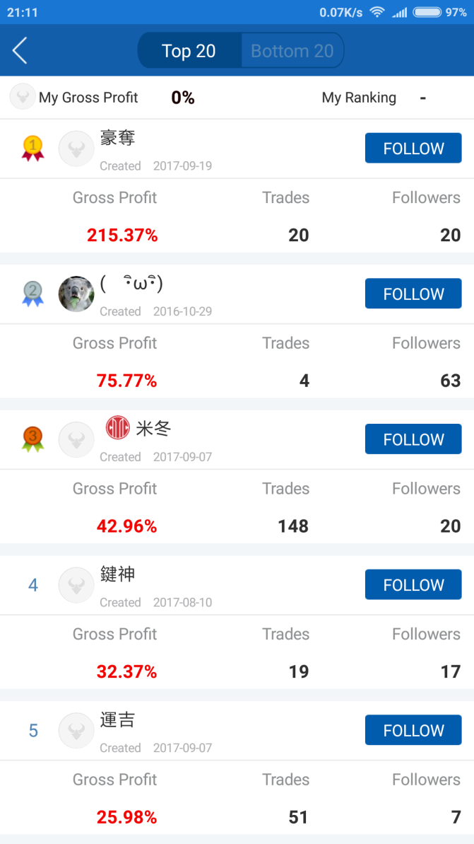

Example: Social Trading
Learn user trading patterns and behaviors
Money-making users can get paid for viewing their profitable portfolios and transaction notifications
Snowball / Xueqiu (雪球)
Game stop

Slide 21
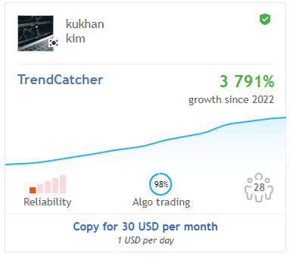
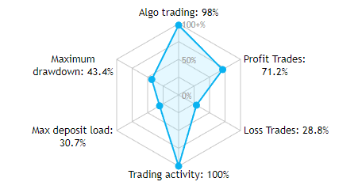
Example: Social Trading
MetaTrader 5 Trading Signals with Automatic Execution

Slide 22
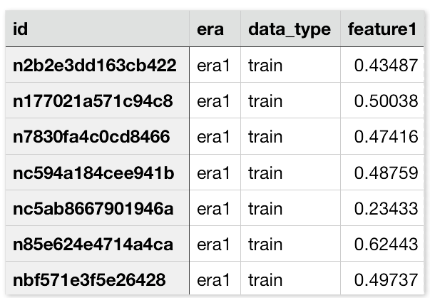
Example: Social Trading
Numer.ai
No data scientist has a machine learning model that is better than all the others
Not a search for the ‘best’ model; it is a platform to synthesize many different models with many different characteristics
Collaboration to build the meta model
Reward with cryptocurrency

Slide 23
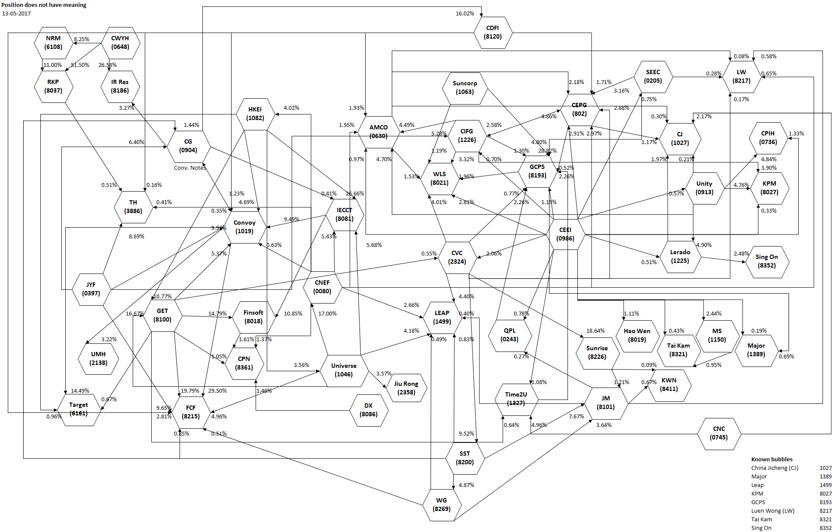
Example: Detect Unusual Trading Activity
The Enigma Network: 50 stocks not to own (David Webb)
Published: May-2017
Dec-2017: ICAC arrests Convoy (康宏) chairman at the airport

Slide 24
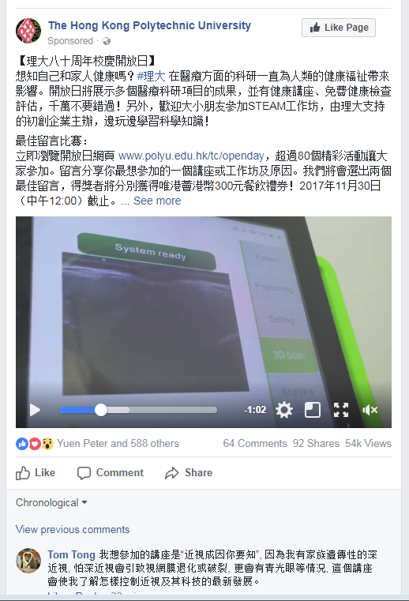
Datatact: Intro
Social Media Big Data Analytics
Fan Pages (1K +)
Posts (2.7M +)
Comments (35M +)
Reactions - Like, Love, Haha, Angry, Wow, Sad (50M +)
Shares (5M +)
Date: from 2009 to 2018-4 (Cambridge Analytica Scandal)
Co-founder’s Project

Slide 25
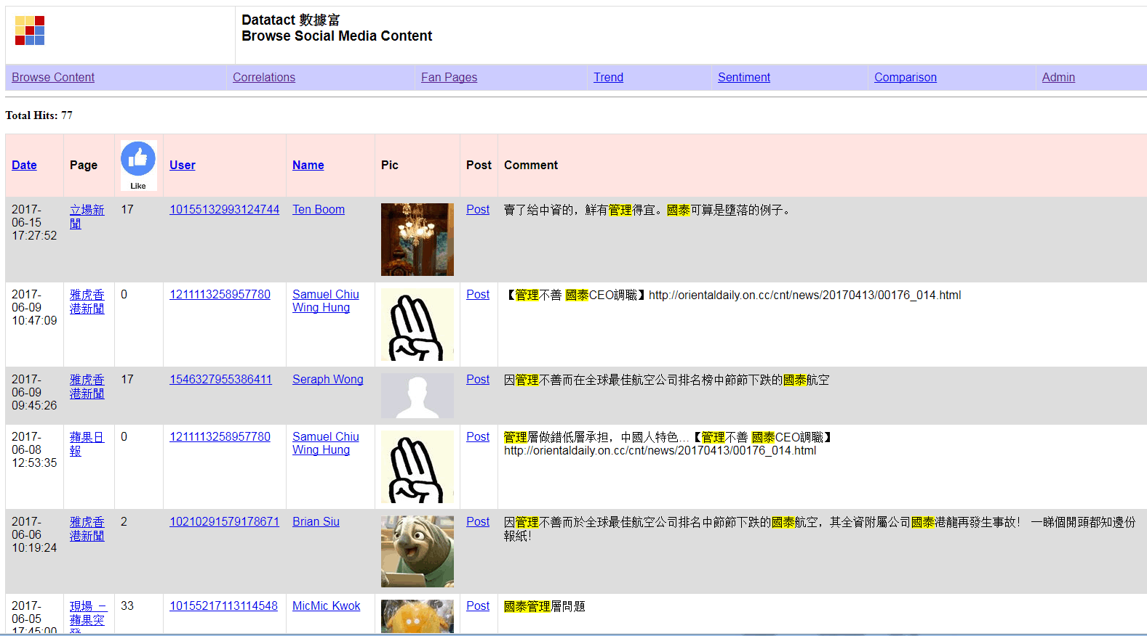
Datatact : Social Listening
Public images of Cathay Pacific
2017/07/12

Slide 26
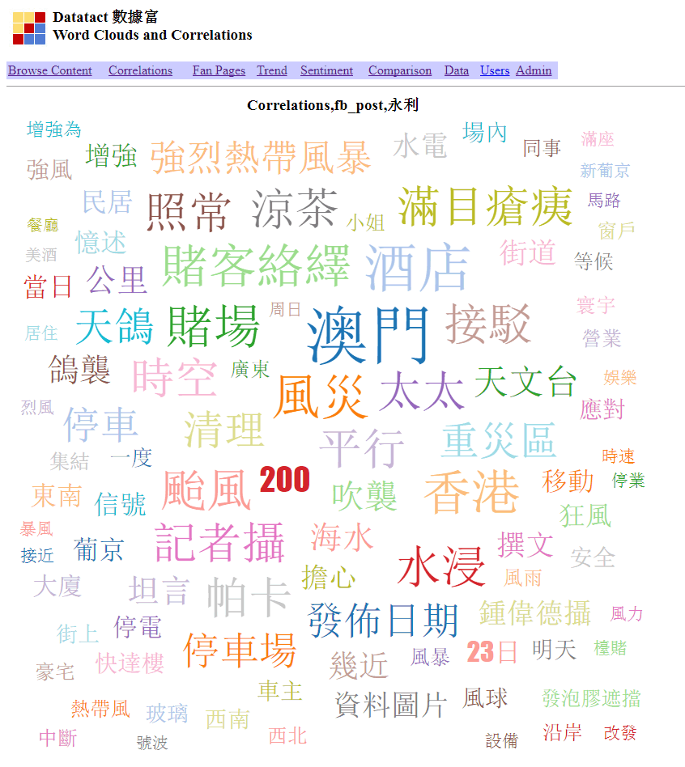
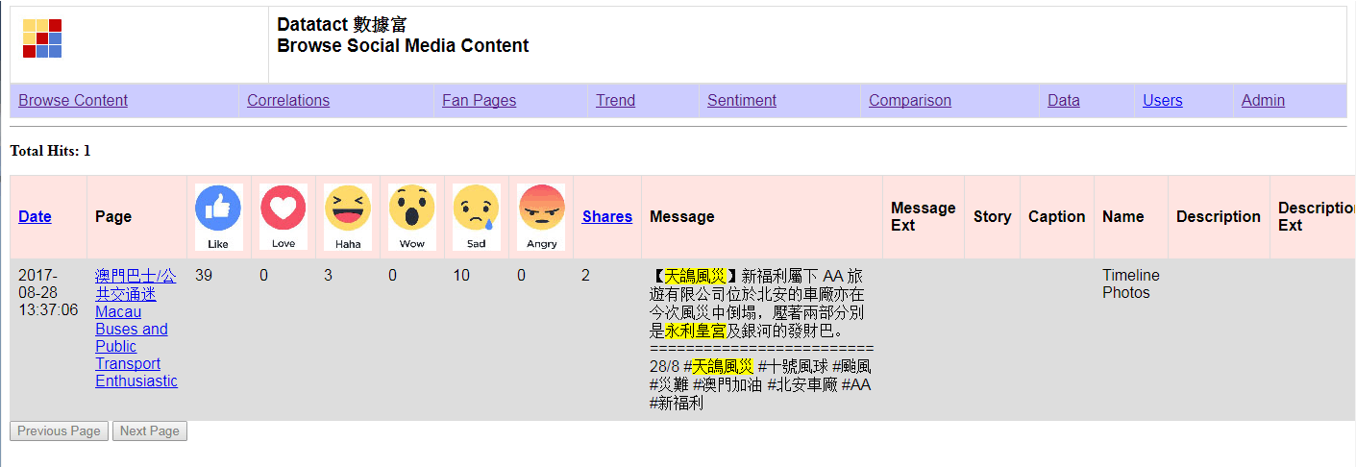
Datatact : Social Listening
Impact of Hato Typhoon to Macau Casinos (Wynn)
2017/08/30

Slide 27


Datatact : Content Farm
Generate large amounts of textual content to satisfy algorithms for maximal retrieval by automated search engines or to generate advertising revenue through attracting reader page views

Slide 28
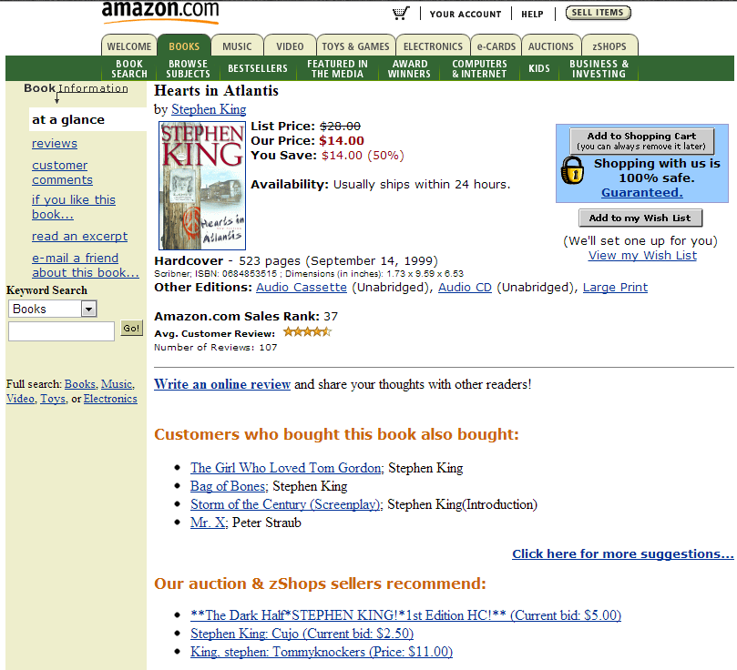
Amazon Books Recommendation

Slide 29

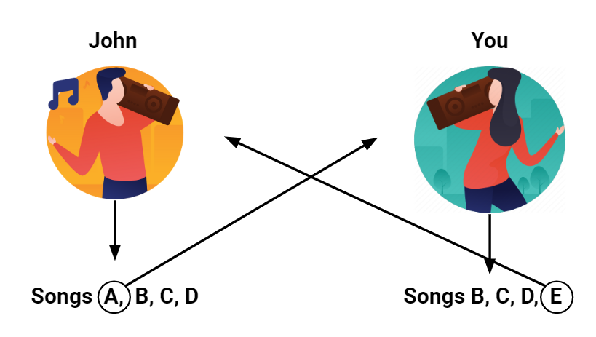

Songs and Movies Recommendation
Discover Weekly playlist: Spotify finds songs that fit your profile but you haven’t listened to
How Does Spotify Know You So Well?
Collaborative Filtering

Slide 30
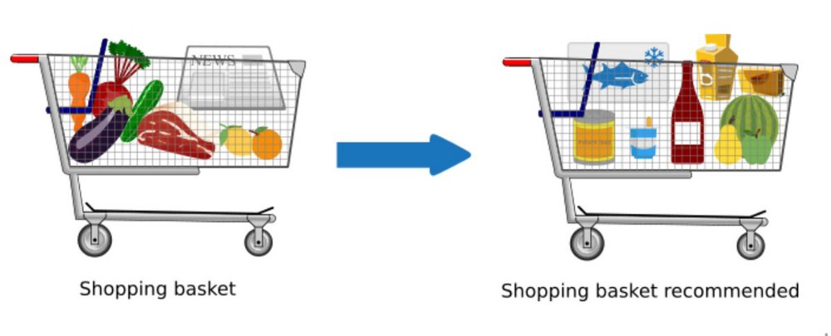
Datatact : Product Cross-selling
Market Basket: identifies the strength of association between pairs of products purchased together and identify patterns of co-occurrence.
Apriori: https://www.youtube.com/watch?v=TcUlzuQ27iQ
FP-Growth: https://www.youtube.com/watch?v=vPcJEFFWN_k&t=18s

Slide 31
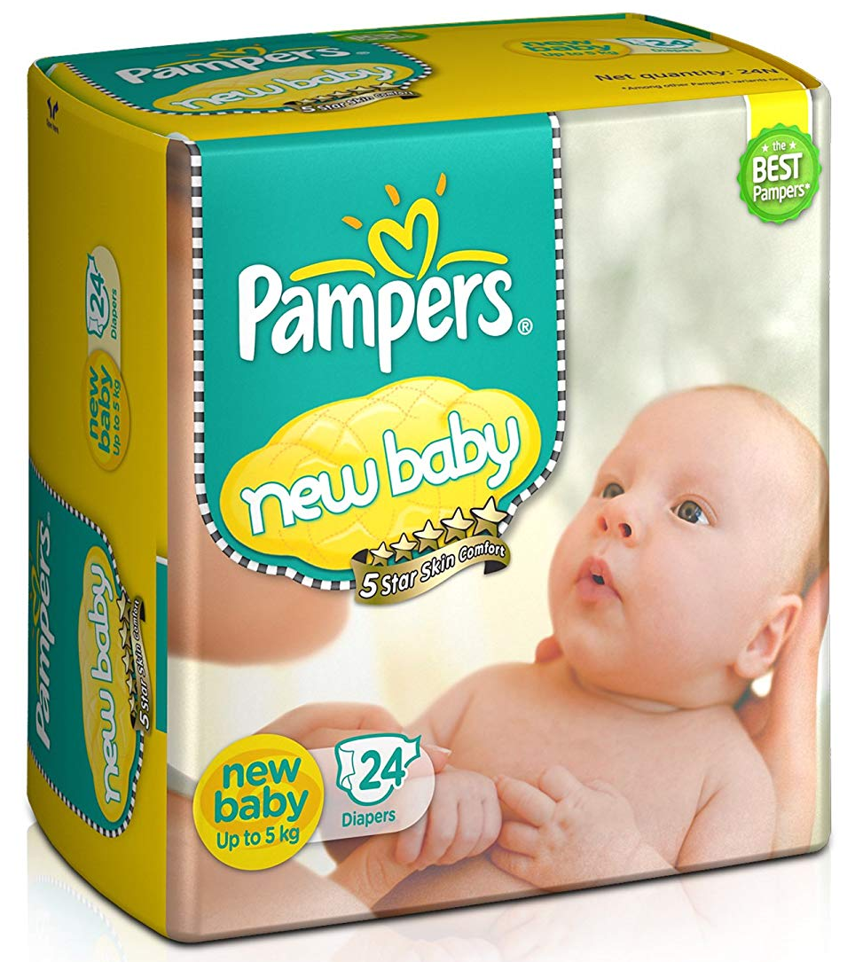
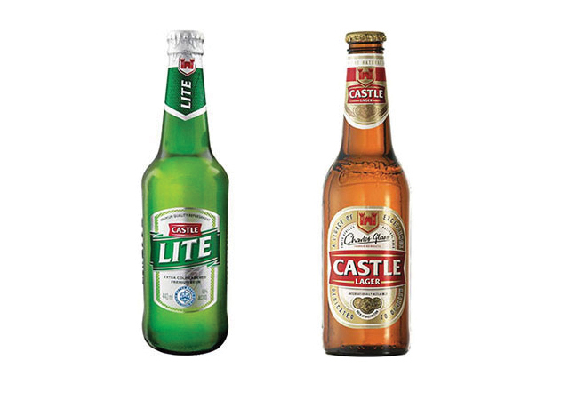
Datatact : Product Cross-selling
Supermarket Diaper & Beer Story

Slide 32




Datatact : Product Cross-selling
Datatact Example on Beauty Fan Pages

Slide 33

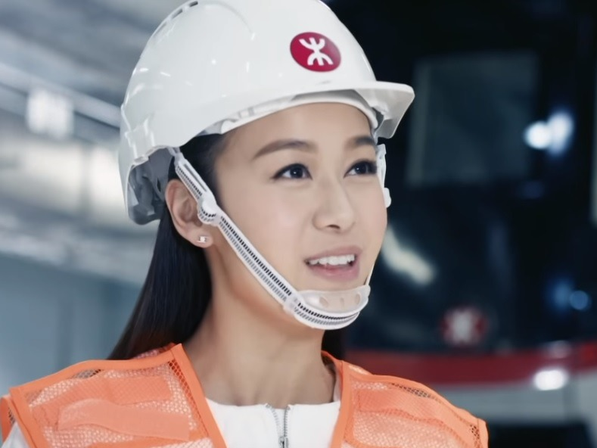
Datatact : Crowd Opinion Leader
Big companies may use famous people (KOLs) to promote their brands. But they are usually too expensive for small companies.
But effectiveness is not guaranteed !
MTR derailed

Slide 34
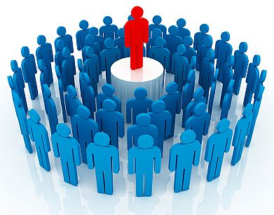
Datatact : Crowd Opinion Leader
Every customer is also a marketer
Disrupt the marketing industries by linking the brands to the customers directly where the customers are both their marketers and buyers at the same time

Slide 35
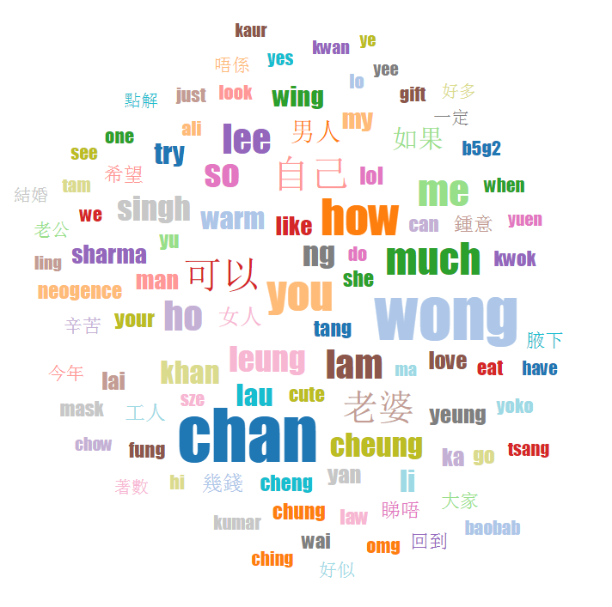
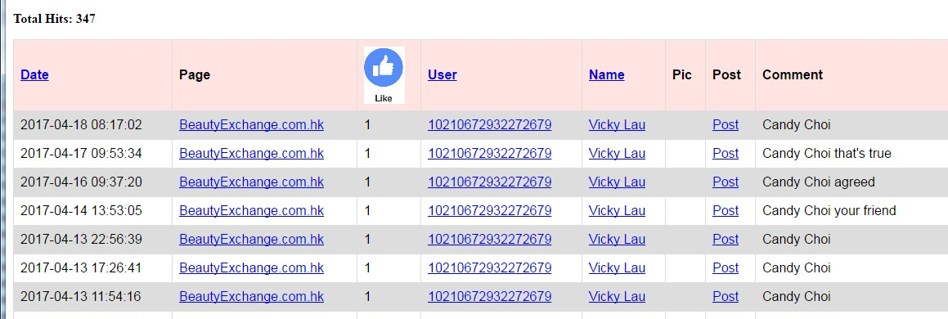
Datatact : Crowd Opinion Leader
In Social Media (like FB), friends like to tag each for certain brands and products
A word cloud from the 200 Beauty related FB Fan Pages shows that many comments are friends “names”
The details reveal a particular user tagging her friend frequently

Slide 36
Datatact : Crowd Opinion Leader
Observations
Those users who are actively tagger their friends for products are, in a way, helping to market the brands
Through the network of friends, it would be easier to sell the products as it solved the issue of talking to a strangers
There can be a timing benefit as a friend may know another friend who is currently looking for a particular product
Goals
Turn people into COLs (e.g. our data reveals who are most active on certain categories of products and actively tagging their friends)
Those COLs work for the brands for rewards; while the brands leverage them to increase the sales to their network of friends
Every customer is also a marketer! Linking the brands to the customers directly where customers are both marketers and buyers

Slide 37

Datatact : Crowd Opinion Leader
COL Identification
Friend List: number of friends
COL Profile: trace the user actions
Activity Heat Map: based on the activity metrics which include the frequency of tagging friends, reactions (likes, angry, wow) to particular content or comments
Friends reaction: tagged friends like it or reply with positive comments
Goals
Match the COL profile to the appropriate brands/companies
COL matching fee is based on the effectiveness (e.g. Feedback Rate, the usage of discount coupon issued by the COL)
Make the COL exclusively for a company will incur additional charge

Slide 38
Datatact : Crowd Opinion Leader
Revenue Opportunities
HK market has estimated 3.76 millions active FB users in 2019
https://www.statista.com/statistics/558226/number-of-facebook-users-in-hong-kong/
Each user can be engaged in multiple expertise areas where average COL matching fees is estimated to be HK$ 1,000 per case
HK Market | Revenue (HK$)
Estimated active HK Facebook users | 3,760,000
No. of expertise area per COL | 5
Ratio of one COL to their friends | 1 to 20 (0.05)
Matching fee of each COL case | $ 1,000
Total | 3,760,000 * 5 / 20 * $1000 = $ 940,000,000 (940 M)
Capture 5% of the total | 5% * 940,000,000 = $ 47,000,000 (47M)

Slide 39
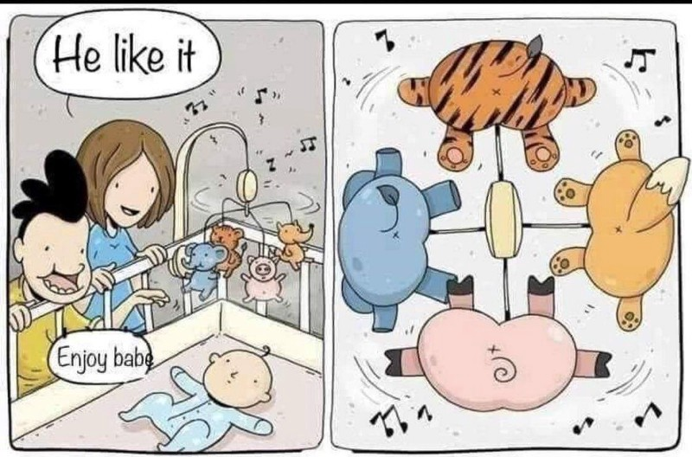
Datatact : Challenges
It’s important to understand how the end user uses the product

Slide 40

Datatact : Challenges
Hong Kong market is small and not many Cantonese specific tools
Nice to have but not critical. Hence many customers ask for prototype but no one really put down real money
Data analytics is free or at very low cost (just as software is free) as it’s not a tangible thing. Look for actions or real results (not data)
Non-genuine clients try to exploit the knowledge

Slide 41
Development Pipelines
Collect data from Facebook
Storage (Database)
Pre-process: Cleaning, Small Caps, Tokenize, Remove StopWord, Word Stemming etc
Index
Search Query
Relevance and Sorting
Visualization & Interpretation

Slide 42
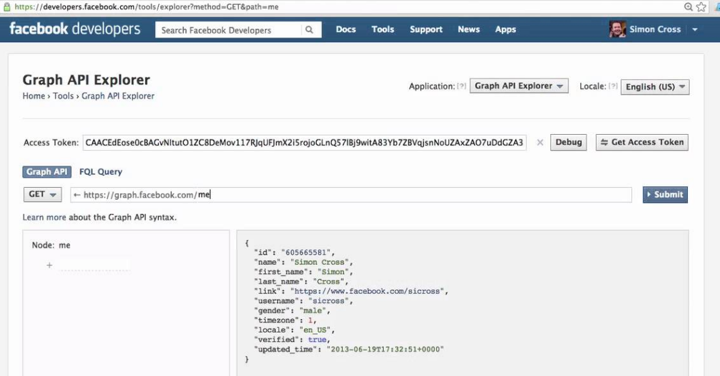
Data Extraction
Meta (facebook) developer account: https://developers.facebook.com/
How To Set up Facebook Developer Account & Create Facebook App ID
Getting Started with the Graph API

Slide 43
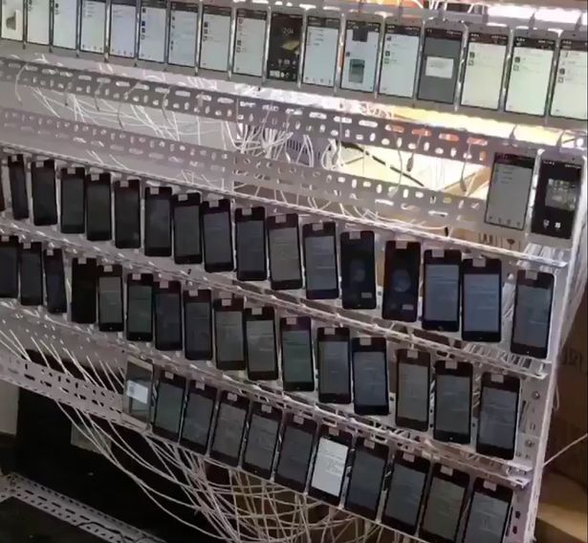
Data Extraction
Manage Facebook accounts
Disconnect and retry
Throttling
Privacy limitation (only public fan pages)
Cambridge Analytica Scandal: Facebook Allowed Firm To Exploit Data To Target American Voters

Slide 44
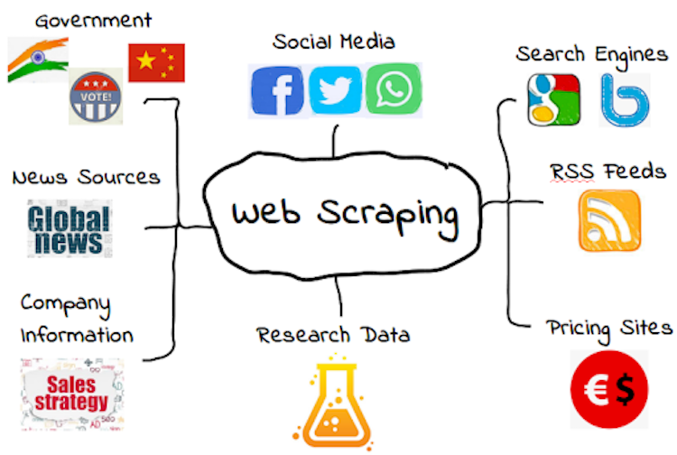
Data Extraction
Web Scraping: Free data from the Internet web sites
Code demo on scraping Nike Website
Notes:
FB post and comment is like news vs social feeds

Slide 45
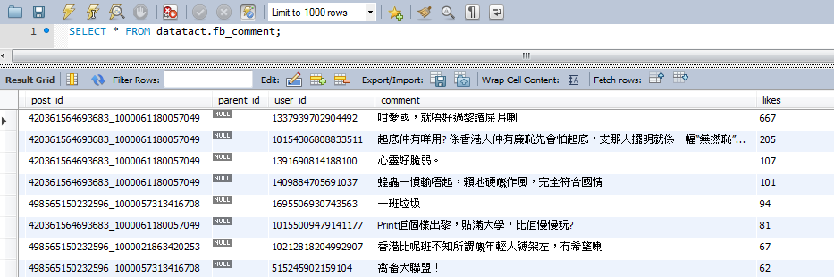
Data Storage
(Relational) Database
Durable
Handle concurrency (multiple writer)
Fast retrieval

Slide 46
Text Pre-processing
Cleaning
Remove symbols (, [ ] \ ! # etc)
Remove URLs
Tokenize (Break the sentence into words)
English is easy but Chinese is not
Example:
兒子生性病母倍感安慰
兒子 / 生性病 / 母 / 倍感 / 安慰 (Wrong: a mother is happy about his son getting sexual disease)
兒子 / 生性 / 病母 / 倍感 / 安慰 (Correct: a sicken mother is happy about his son being good)

Slide 47
Text Pre-processing
Remove Stop Word
English: a an the
Chinese: 的 了 嗎
Small Caps
Convert all English letters to small caps
Word Stemming
English: stems stemmer stemming stemmed
Chinese: 香港大學, 港大, hku
Code Example

Slide 48
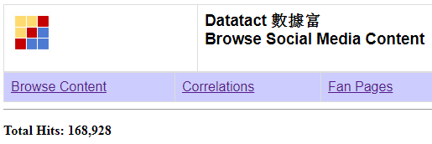
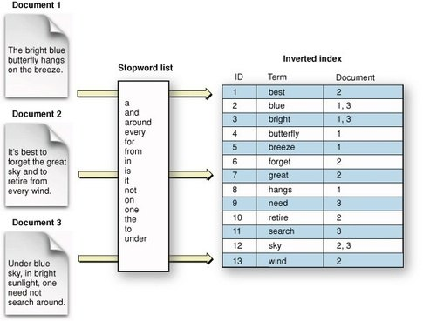
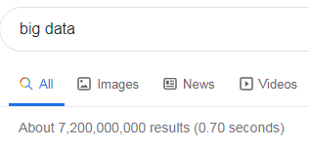
Searching
Inverted Index

Slide 49
Social Media Ranking
Sort by Date
Sort by
Sort by Popularity Index
10*comment + 5*Love + 5*Angry + 4*Sad + 3*wow + 3*haha + 2*Comment_like + Page_like

Slide 50
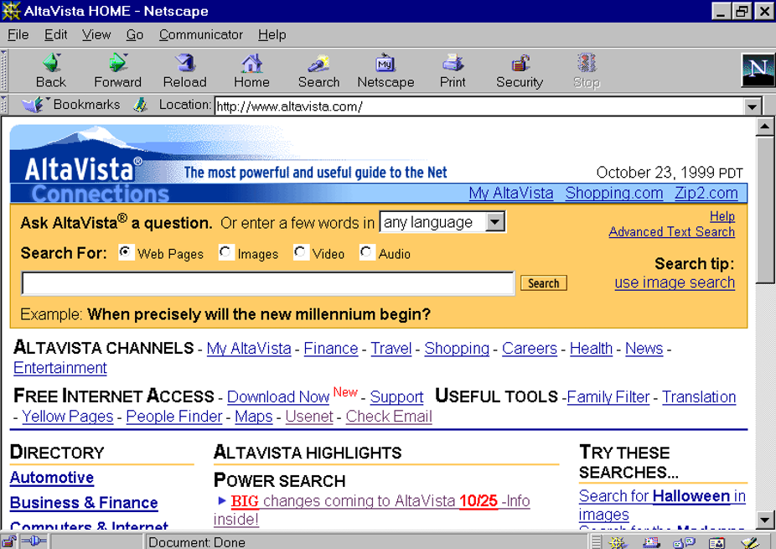
Website Ranking
How to rank and display the top 10 from the 1 millions matched results?
AltaVista in 1995: ranking is primarily based on text

Slide 51
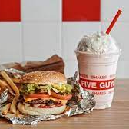

Website Ranking
kenliu.com
best hamburger
Billion dollars insight: Google realized that relevance depended on trust, not just text
fiveguys.com
weight = 1
Trust is calculated by counting “weighted” back-links Each link is like a vote or endorsement (PageRank Algorithm)
food.com
hamburger review
weight = 5
Weight = 10
BBC.com
people love hamburger

Slide 52
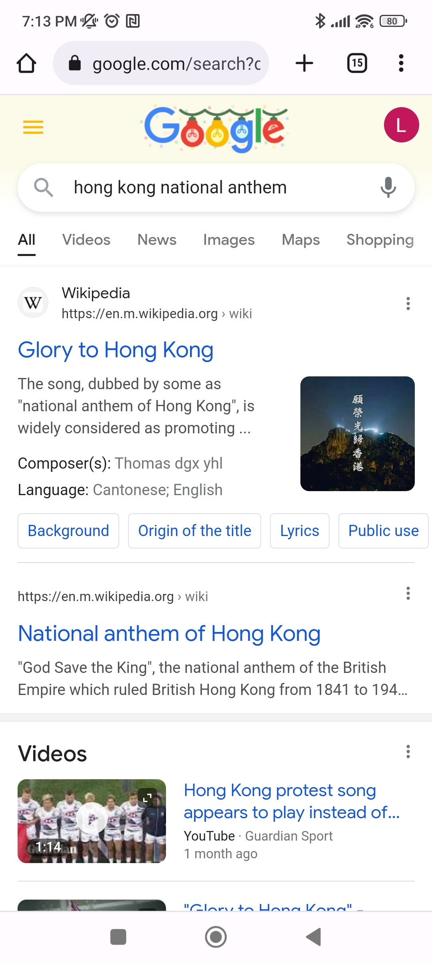
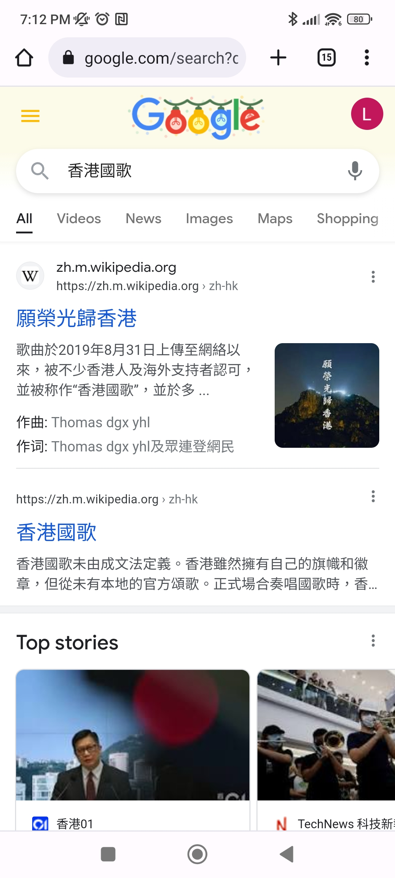
Website Ranking
SEO (Search Engine Optimization)

Slide 53
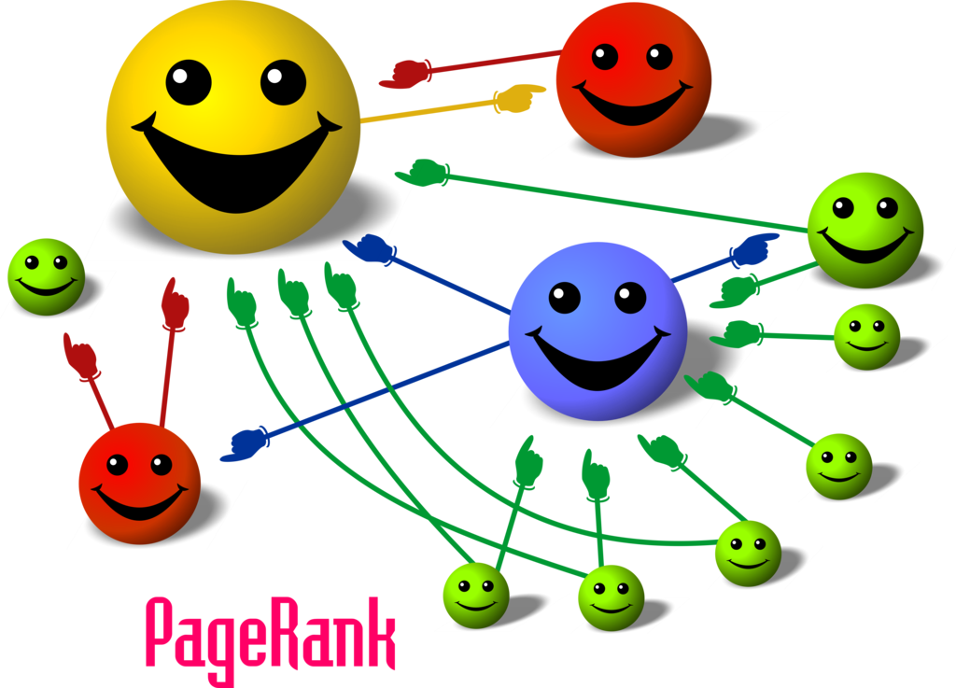
Google PageRank
What’s the biggest challenge to make PageRank accurate?
How many back-links for a particular website in total?
In order to count the total back-links, needs to know all the links from all other web sites in the world.

Slide 54
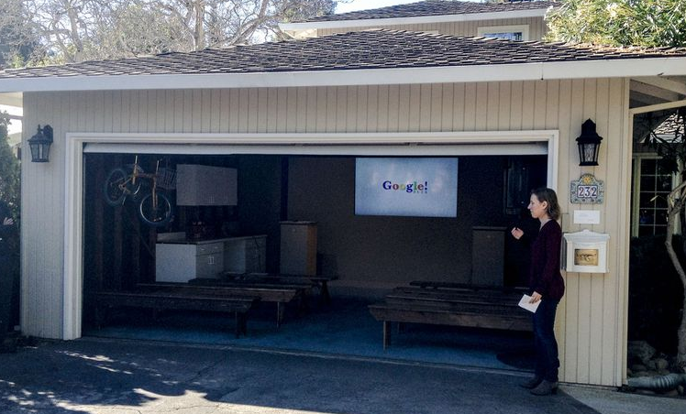

Google PageRank
Hence Google stores (caches) entire Web by Crawlers or Spiders.
A large storage hardware is very expensive. When the data volume grows further, no single storage is large enough
From Garage to Data Centres
Combine many commodities storage hardware in large data centers

Slide 55

Big Data
Internet scale of data is Big Data

Slide 56
Big Data
How big is Big Data
Big Data with 8 V’s
Mum is a female
(阿媽係女人)
8 V’s is not necessarily Big Data
Female is not necessarily a mum
(不等如 女人係阿媽)

Slide 57


Big Data
What exactly is Big Data? How big is big (quantitatively)?
One possible answer: need multiple commodity storage hardware to store all the analytics data now or very soon (i.e. the data growth rate is fast)

Slide 58
Big Data
When you have many “commodity” computers (storage units) connected for a “big” data solution:
Moving data around the network is extremely slow
Some storage units may be failed from time to time and need data redundancy (i.e. store the same data into to multiple units)
Where (which computer) to store a particular data that can be retrieved back quickly

Slide 59

Key Technologies - Hadoop
Hadoop Distributed Filesystems (HDFS)
Map Reduce
Hashing
Tree
SQL vs NoSQL

Slide 60

Map-Reduce - Data Parallelism
When you have many data and many computers, what’s the best way to work on it?

Slide 61

Map-Reduce - Data Parallelism
Moving the program to the data (rather than data to the program)
Split the task, compute sub results and combine them back for final result

Slide 62


Hashing - Indexed by Calculation
One computer cannot host all the data and need to distribute into multiple computers (clusters of computers)
Hash function determine what data to store in which computer
h(x) = integer

Slide 63

Do you need Big Data Solution
Datatact Data Count
Facebook | Counts
Posts | 2.7M +
Comments | 35M +
Reactions (Like, Love Haha, Angry, Wow, Sad) | 50M +
Database size: 95.6 GB
Index size: 18.2 GB
Total: 113.8 GB
128 GB

Slide 64

Do you need Big Data Solution
Western Digital Red Edition (NAS)
Capacity (TB) | HK$ | $/TB
2 | 421 | 211
3 | 603 | 201
4 | 665 | 166
6 | 977 | 163
8 | 1,277 | 160
Source: price.com.hk as of 2022/10/18

Slide 65

Do you need Big Data Solution
Synology DiskStation DS420j
4-Bay NAS: HK$ 2,178
4 x 8 TB ($1,277) = 32 TB: HK$ 5,108
Total = $ 7,286
Datatact 113.8 GB / 32 TB = ~0.36% ➔
281 years of linear growth or
15 years of 50% exponential growth

Slide 66



Do you need Big Data Solution
How Datatact stores the data
MySQL : traditional relational database for data storage
Apache Lucene: inverted index for fast data searching and ranking
No Big Data solution is required

Slide 67

Do you need Big Data Solution
Google, Yahoo, Facebook etc. needs Big Data solution, but do you?
Are you a web-scale data company ? Do you have a billion customers generate large amount of data daily?
Is your data volume already more than a single storage hardware? Or the data grows exponentially (i.e. much faster than the growth of single-disk storage capacity)?
>> If not, probably you don’t need Big Data solutions

Slide 68

Do you need Big Data Solution
How many storage to digitize 200K CVs ?
(average CV is 3 pages)
 | CVs | GB | TB | 32TB %
Jobs Search Co. | 200K | 2 | 0.002 | 0.01%
HK Population | 7M | 70 | 0.07 | 0.22%
China Population | 1.4B | 14,000 | 14 | 43.75%
World Population | 8B | 80,000 | 80 | 250.00%

Slide 69


Do you need Big Data Solution
Every data related applications is Big Data

Slide 70


Do you need Big Data Solution
But everyone is talking about Big Data, someone use it as it sounds cool !

Slide 71
Appendix
~ Appendix Section ~

Slide 72

Individuals: Social Media
Apple co-founder Steve Wozniak: "Apple makes its money off of good products, not off of you," Wozniak said. "As they say, with Facebook, you are the product.“
TIME Person of the Year 2006
You
Google Trend in HK

Slide 73


Example: P2P Lending
LendingClub. enables individuals to borrow and lend money without the use of an official financial institution as an intermediary
Monexo Lender

Slide 74


Example: P2P Insurance
Friendsurance: P2P Insurance. “If there are zero or just a few claims, the members of the group receive a share return from the cashback pool. Insurance customers enjoy full coverage and never pay more than they would.
Mobile Data Plan P2P

Slide 75



Example: Insurance Apps
Manulife Move
AXA Xtra
FWD Drivamatics
HK Blue Insurance (by Aviva)

Slide 76


Example: Personal Health
Iridology: BiliScreen uses a smartphone camera, computer vision algorithms and machine learning tools to detect increased bilirubin levels in a person’s sclera, or the white part of the eye
Selfie Food for Diet Analysis

Slide 77

Example: HSBC Ask Amy Chatbot
Give it a try
use whatsapp to train chatbot
Revamp of 1823 Website with Chatbot Service, to facilitate the public to to access government information more directly and to answer simple enquiries
South Korean virtual girl iPhone app

Slide 78
Example: Amazon Alexa
Incoming customer call
Hi Nikki Wolf, based on unusual activity, we have locked your Credit Card. Is your call related to this? If so, please enter the onetime code sent to your phone.
Sure, the code is 12345.
Thank you. Your credit card is now unlocked and you should be able to proceed with the transaction.
Great, thank you!
CRM content
Data
Dip
DYNAMIC Amazon Connect answers customer questions before they are asked
PERSONAL Contact flows adapt on a per customer basis
NATURAL Connect integrates with Amazon Lex to give the apply speech recognition and natural language understanding technology that powers Alexa to customer interactions
Google Duplex helps to book restaurant
Voice Usage in TV program selection (e.g. myTVSuper)
HK Call Center -> GZ/Philippines -> Alexa/Siri

Slide 79


Example: Detect Unusual Trading Activity
Hong Kong stock exchange enlists AI in fight against rule breakers
Analyses historical trading activities to identify patterns and anomalies, such as dramatic rise in trading volume or wild swings in share prices.

Slide 80

Alternative Data Breakdown
Breakdown of alternative data sources used by the buy side. Source: Neudata

Slide 81
Alternative Data Evaluation
Factor | Description
Data history length | The earliest point from which historical point in time data is available
Data frequency | The frequency with which data can be delivered
Universe coverage | How many investable companies the dataset relates to
Market obscurity | How well-known this dataset is to institutional Investors
Crowding factor | How many hedge funds and asset management clients are using this dataset
Uniqueness | How unique this specific dataset
Data quality | Completeness, structure, accuracy and timeliness of data
Annual price | Annual subscription price charged by the data provider

Slide 82

Alternative Data Evaluation
Satellite imagery tracking economic activity in China. A manufacturing index based on images of around 6000 industrial sites across covering 500,000 square km.
Data points delivered three times per week with a two-week delay. History is available from 2004
Index claims better than the Chinese Purchasing Managers Index (PMI), as it is questioned for a lack of accuracy and reliability.
In 2017, has four clients receiving the same underlying data. In 2018, mapping specific industrial sites to underlying companies
China manufacturing dataset. Source: Neudata.
Alternative Dataset Providers
Eagle Alpha Report (P.38 for case studies)

Slide 83

Alternative Data Summary
Free Data Source

Slide 84

Datatact: Intro
Keyword Search:打風 颱風

Slide 85

Datatact: Intro
Correlation:
打風 颱風

Slide 86

Datatact: Intro
Sentiment: Based on Facebook user comments on the Fan Pages

Slide 87

Datatact: Intro
Visualization: Fan Pages users by countries

Slide 88

Key Technologies - Hadoop

